Slide 1
ANALYZING AMAZON SALES

Slide 2
Introduction
Overview of Sales Performance: Analyze key metrics such as total units sold, profits, and sales channels to understand Amazon's overall sales performance.
Regional Sales Insights: Examine how sales vary across different regions, identifying which areas contribute most significantly to total sales and profits.
Product Category Analysis: Assess the profitability and sales volume of various product categories, highlighting top-performing items and potential areas for growth.

Slide 3
Details Of Data
Total Profit by Item Type:
Cosmetics lead with the highest total profit.
Household and office supplies follow as significant contributors.
Total Units Sold:
A total of 513K units have been sold globally.
Countries:
Sales span across 76 countries worldwide.
Units Sold by Region:
North America accounts for the highest sales (35.7%).
Europe and Asia follow with 19.1% and 13.3% respectively.

Slide 4
Details Of Data
Average Delivery Time by Order Priority:
High priority orders have the shortest average delivery time (21.40 days).
Medium priority orders take the longest (25.33 days).
Units Sold by Sales Channel:
Online sales make up 53.97% of total units sold.
Offline sales account for 46.03%.
Country-wise Total Profit:
Albania, Angola, and Australia are highlighted for their respective contributions to total profit.

Slide 5
Main KPIs
Total Profit by Item Type
Total Units Sold
Countries Covered
Units Sold by Region
Average Delivery Time by Order Priority
Units Sold by Sales Channel
Country-wise Total Profit

Slide 6
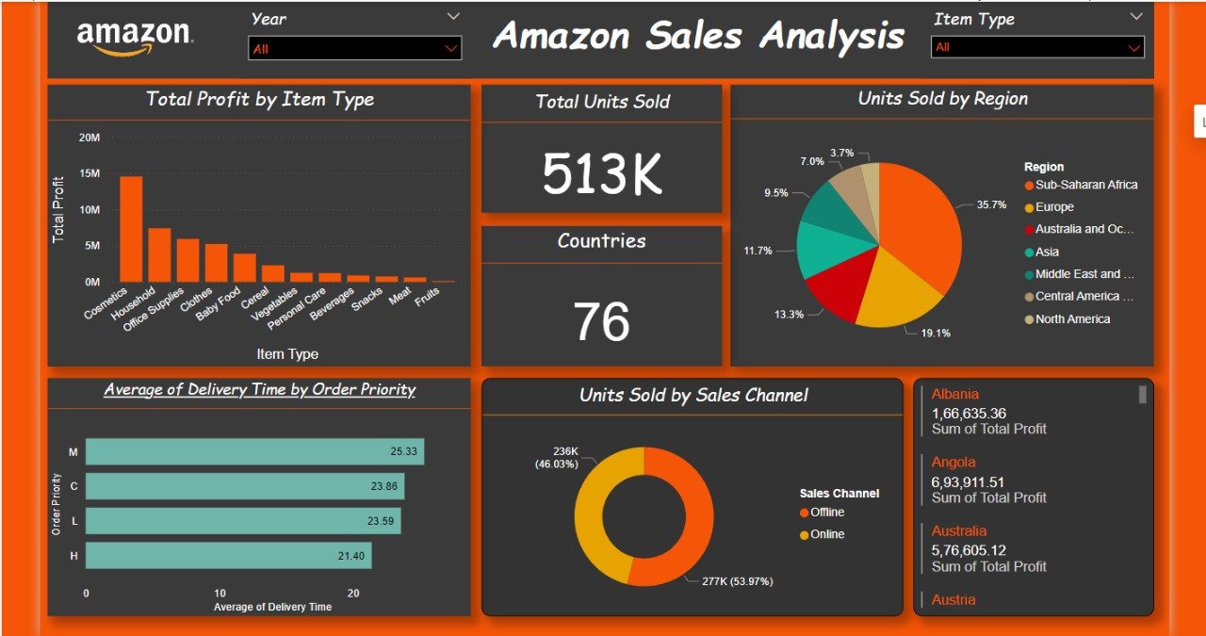
My Dashboard

Slide 7
My Dashboard

Slide 8


